Slide 1



Searching for Red Rings from Weak AGN with JWST NIRCam
Jake Summers
Mentors: Dr. Rogier Windhorst & Dr. Seth Cohen
School of Earth and Space Exploration, ASU
AZSGC Symposium, UA
April 20, 2024

Slide 2
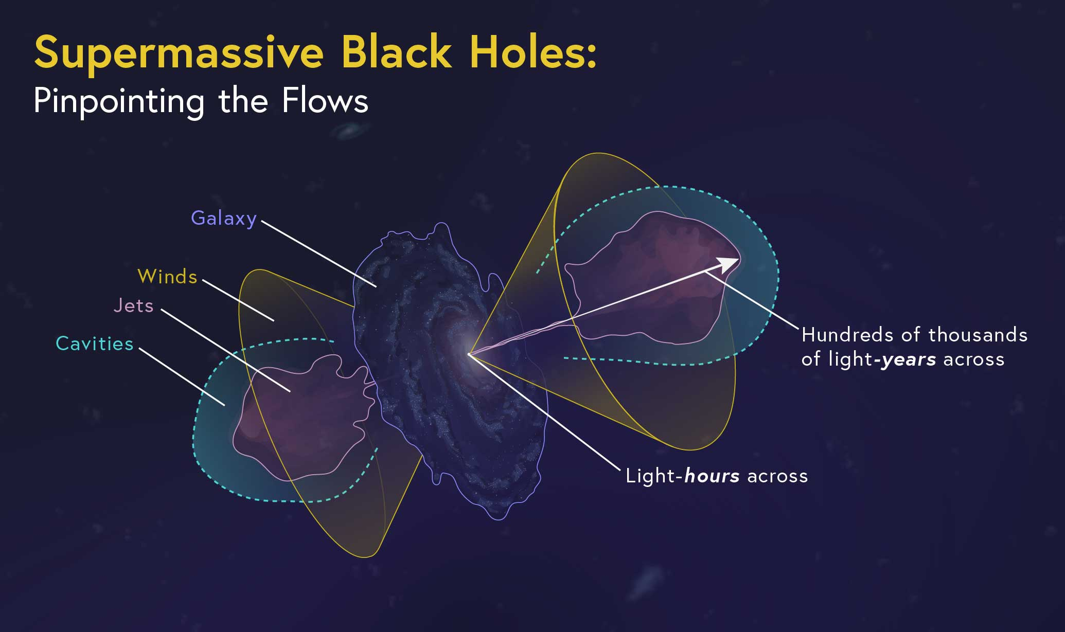
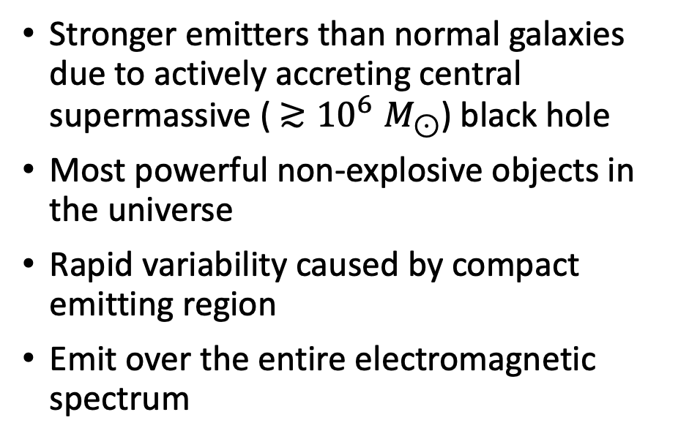
Active Galactic Nuclei (AGN)
Stronger emitters than normal galaxies due to actively accreting central supermassive (${≳10}^{6}M_{⊙}$) black hole
Most powerful non-explosive objects in the universe
Rapid variability caused by compact emitting region
Emit over the entire electromagnetic spectrum
Image Credit: https://webbtelescope.org/contents/articles/what-are-active-galactic-nuclei
Credit: Padovani 2017 – “Active Galactic Nuclei: what’s in a name?”

Slide 3
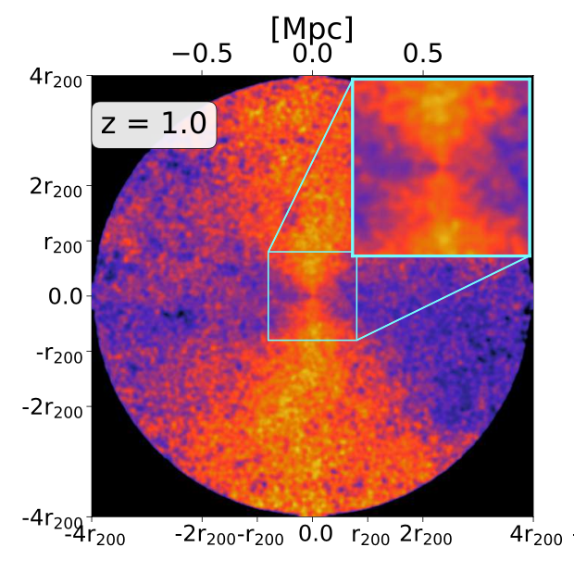
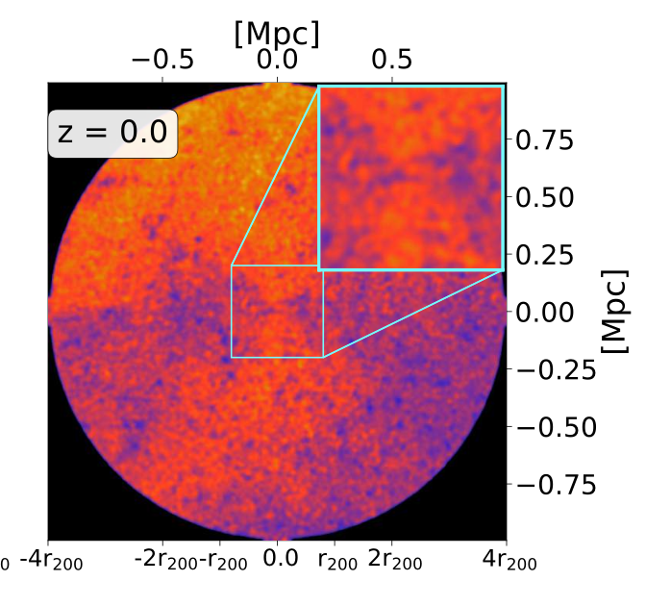
Circumgalactic Medium (CGM)
CGM – Gaseous environment surrounding a galaxy
AGN feedback can release energy into the CGM via radiation from a central accretion disk (for quasar-like AGN) or bubbles and radio jets (for radio galaxies)
For disky galaxies, outflows are preferentially ejected biconically into the CGM
Credit: Yang 2023 – “Feedback-driven anisotropy in the circumgalactic medium for quenching galaxies in the Simba simulations”

Slide 4
Red Rings?
Many objects appear to have a red ring surrounding their center
Color image effects
Spiral structure
AGN outflows?

Slide 5
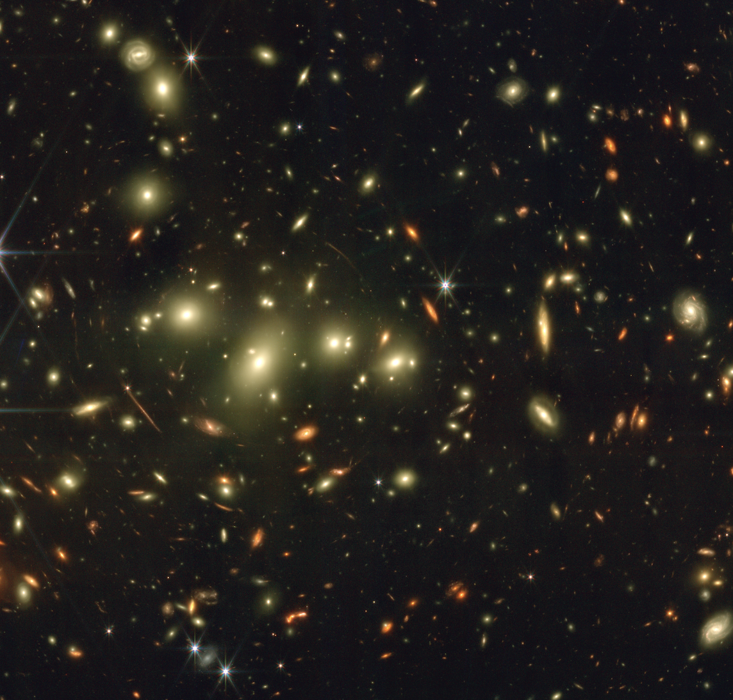
Data – Clio Galaxy Cluster
Redshift z=0.42
Found in the GAMA survey
JWST PEARLS NIRCam data

Slide 6
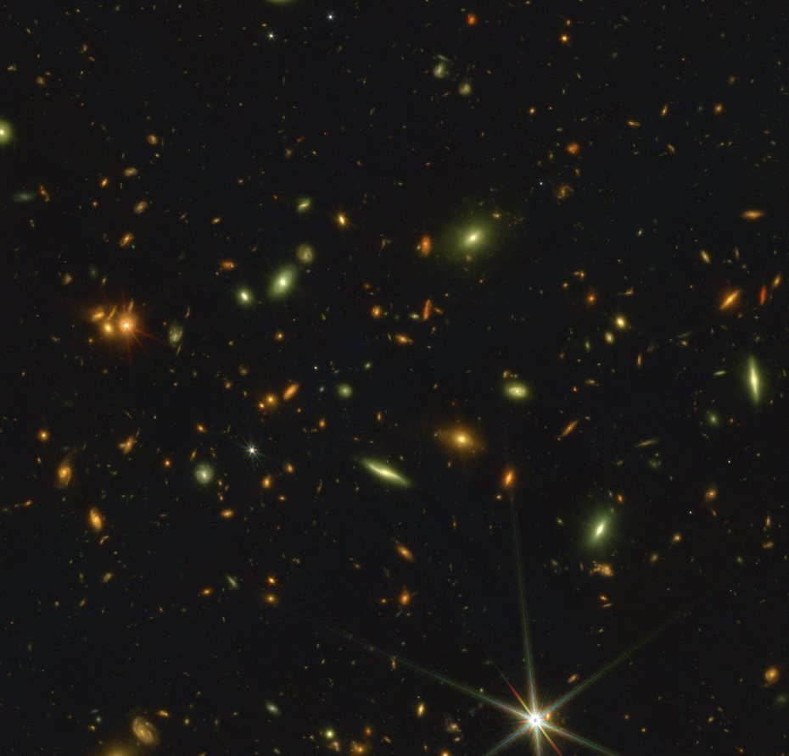
Data – PLCK-G191 Protocluster
Redshift z=2.55
Found in sample of Planck high-z sources
Very high star formation rate
JWST PEARLS NIRCam data

Slide 7
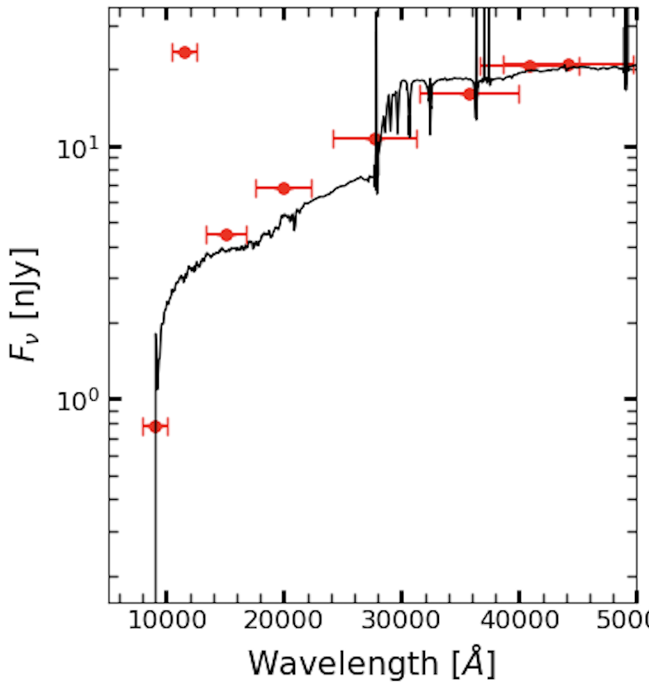
Methods – Source Detection, SED Fitting, & Galaxy Fitting
Source detection done using SourceExtractor
Fit spectral energy distributions with EAZY (Easy and Accurate Zphot from Yale) algorithm to determine photometric redshifts
Fit galaxy morphology using GALFIT, with a bulge+disk Sersic profile

Slide 8
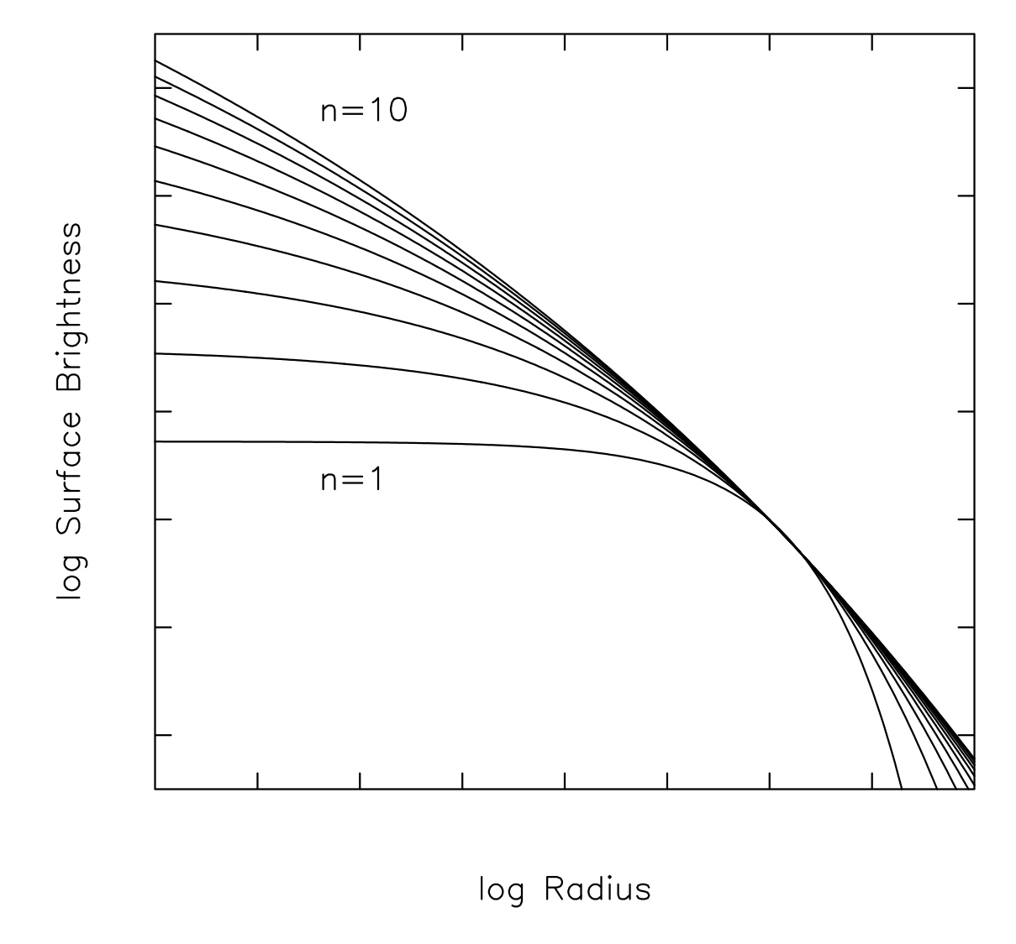
Methods – Galaxy Fitting Strategy
Galaxies generally have multiple components
Disk
Bulge
Others? (e.g., spiral arms, bar structure, etc.)
Need to place constraints on fitting parameters
Assume position and position angle are the same between components
Assume they have similar brightness and axis ratio
Assume bulge component has a larger Sersic index than disk component
Image credit: https://en.wikipedia.org/wiki/Sérsic_profile

Slide 13
Red Rings?
The fit images still appear to have red rings to a significant degree
Red rings are mostly just a color image effect
Some rings may be real

Slide 14
Conclusion
56 red ring candidates found in two JWST fields so far
We fit the galaxies with a double-Sersic fit, and found that the fits themselves still exhibit red ring features in their color images
Fit galaxies exhibit interesting residuals, which could resemble spiral structure, bar structure, or actual dust rings from weak AGN
Perfect galaxy fitting may still be able to reveal real red rings

Slide 15
Acknowledgements
Dr. Rogier Windhorst
Dr. Seth Cohen, Dr. Timothy Carleton, Dr. Rolf Jansen, Dr. Patrick Kamieneski, Ralph Ortiz
The rest of the PEARLS team
ASU/NASA Space Grant

Slide 16
Thank You!
jssumme1@asu.edu

